Slide 1
Comparison of Stochastic Methods for PCA
Corbin Rosset
Edmund Duhaime

Slide 2
Motivation
Goal: find a low dimensional subspace that approximates a larger data matrix
Batch algorithms are slow and scale poorly.
Instead use stochastic or incremental methods
Nearly constant time updates, low memory

Slide 3
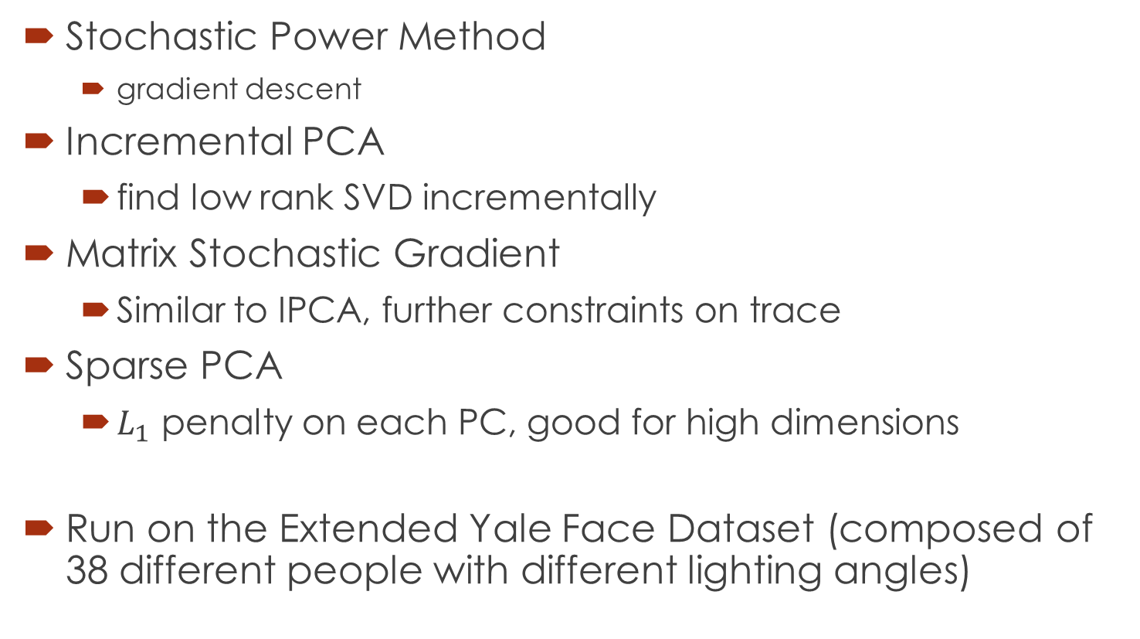
Methods/Algorithms
Stochastic Power Method
gradient descent
Incremental PCA
find low rank SVD incrementally
Matrix Stochastic Gradient
Similar to IPCA, further constraints on trace
Sparse PCA
$L_{1}$ penalty on each PC, good for high dimensions
Run on the Extended Yale Face Dataset (composed of 38 different people with different lighting angles)

Slide 4
Results
Algorithm/Method | % Classification Accuracy
Matlab PCA | 75%
Stochastic Power Method | 63%
Incremental PCA | 75%
Matrix Stochastic Gradient | 71%
SVD PCA | 75%
Sparse PCA | 73%
Direct KNN | 83%
state of the art is 84.42%

Slide 5
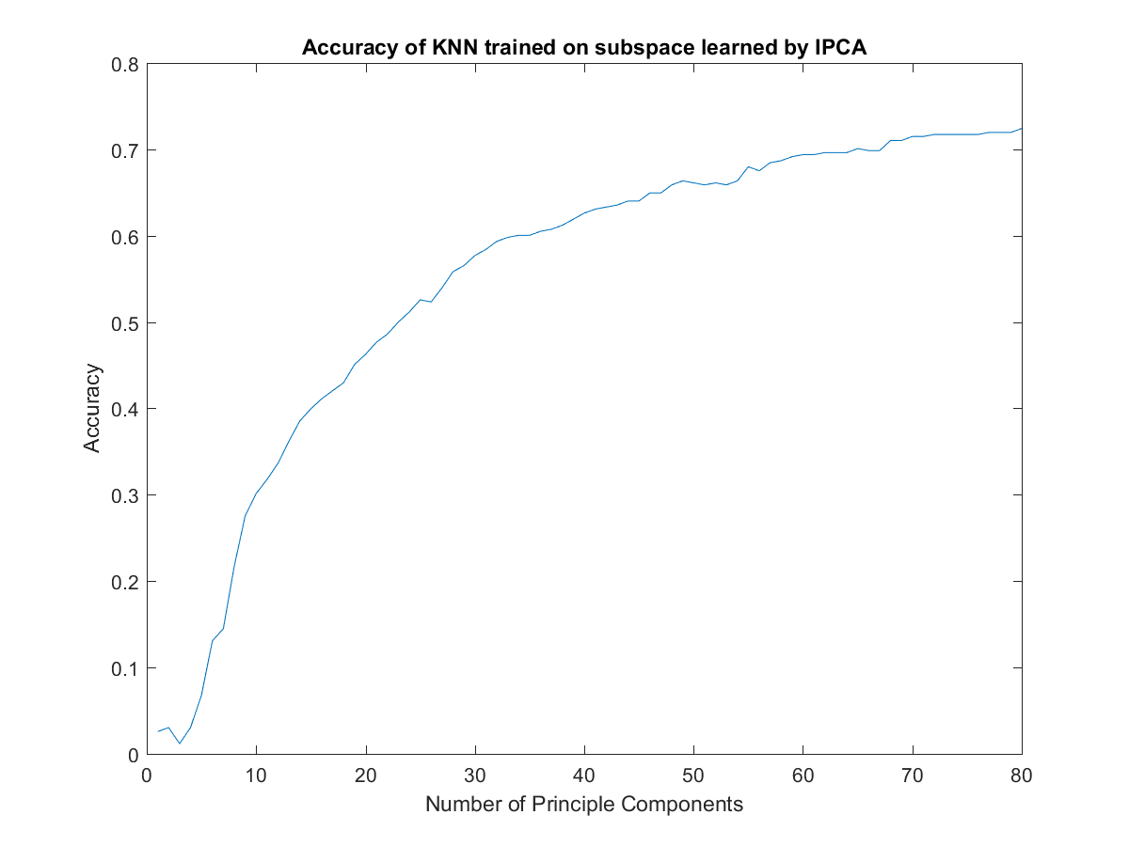

Slide 6
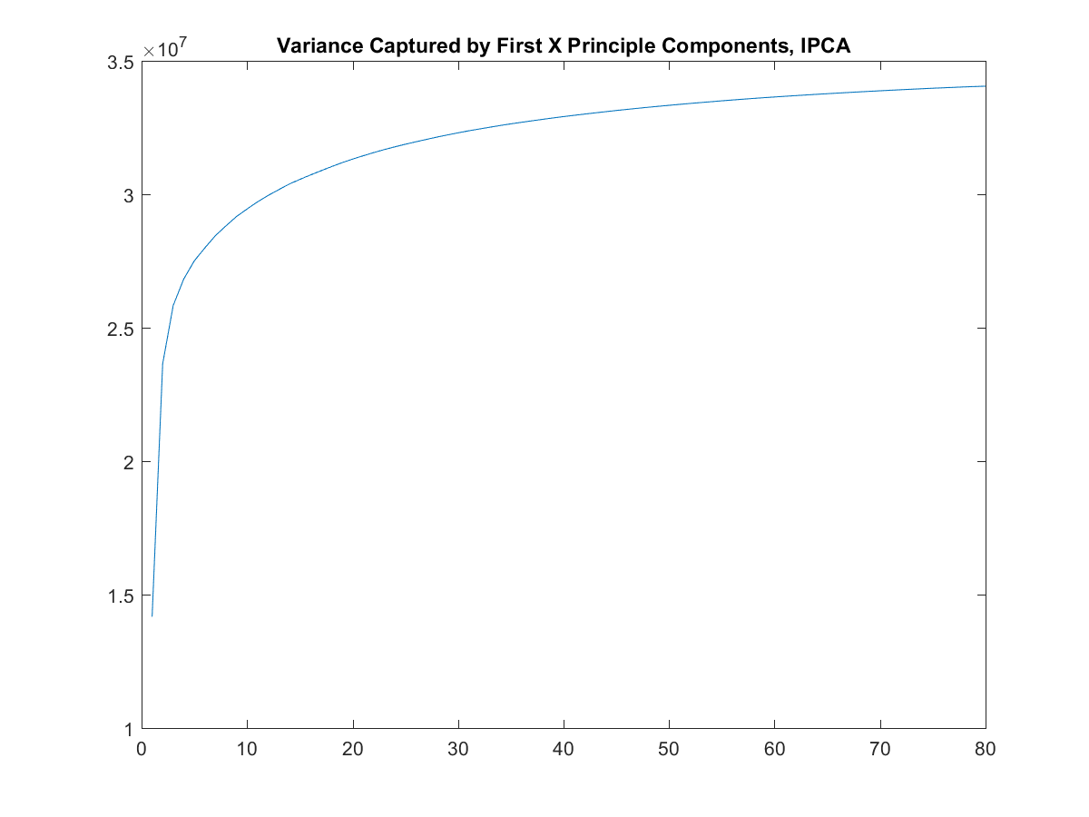

Slide 7
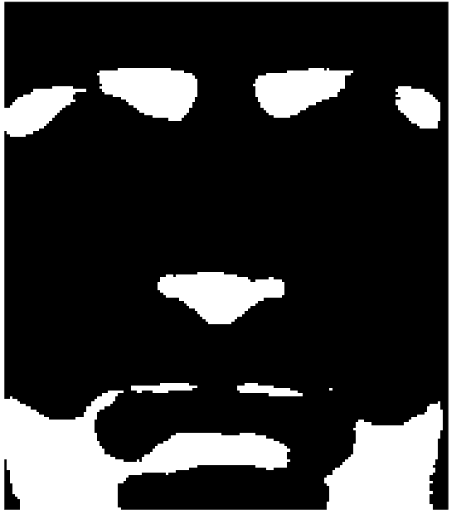
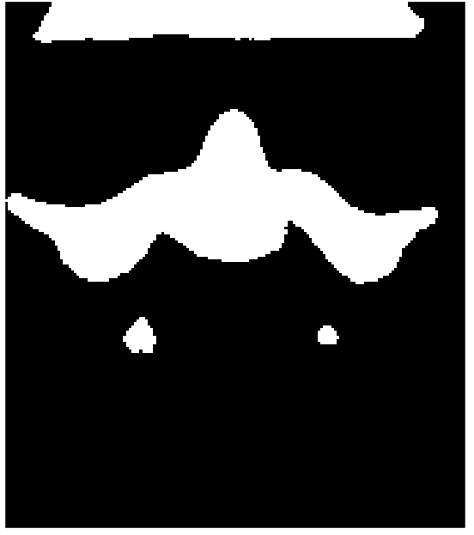
Examples of Features Captured

Slide 8
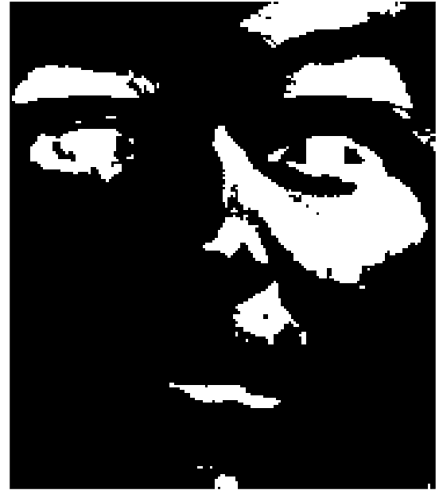
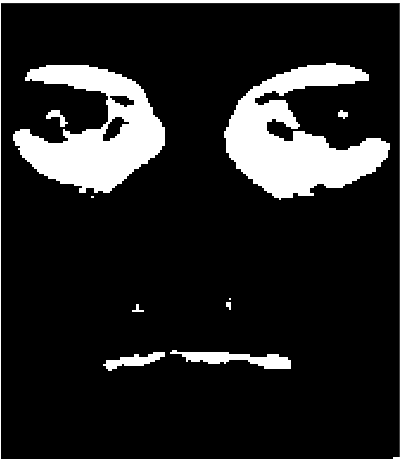
Examples of Features Captured

Slide 9
References
D. Achlioptas. Database-friendly random projections. In Proc. 20th Annu ACM SIGACT-SIGMOD-SIGART Symps. pages 274-281, 2001.
Arora, R.; Cotter, A.; Livescu, K.; Srebro, N., "Stochastic optimization for PCA and PLS" in Communication, Control, and Computing (Allerton), 2012 50th Annual Allerton Conference on , vol., no., pp.861-868, 1-5 Oct. 2012
Arora, R., Cotter, A., and Srebro, N., ``Stochastic optimization for PCA with Capped MSG'', in Archive, 2013, arXiv:1307.1674
Brand, Matthew. {\em Incremental Singular Value Decomposition of Uncertain Data with Missing Values} In ECCV '02: Proceedings of the 7th European Conference on Computer Vision-Part I (2002), pp. 707-720
Clarkson, Kenneth L. "A randomized algorithm for closest-point queries." SIAM Journal on Computing 17.4 (1988): 830-847.
Engebretsen, L.; Indyk, P.; and O'Donnell, R. Derandomized dimensionality reductions with applications. In Proc. 13th Annu ACM-SIAM Sympos. Discrete Algor, 2002.
P. Indyk. and R. Motwani. Approximate nearest neigbors: Towards removing the curse of dimsionality. In proc. 30th Annu. ACM Sympos. 2000.
Johnson, W. B. and Lindenstrauss, J. Extensions of Lipschitz mappingsinto a Hilbert Space. Contemp. Math., 26:189-206, 1984.
Jolliffe, Ian. Principal component analysis. John Wiley $\&$ Sons, Ltd, 2002.
Kushilevitz, Eyal, Rafail Ostrovsky, and Yuval Rabani. "Efficient search for approximate nearest neighbor in high dimensional spaces." SIAM Journal on Computing 30.2 (2000): 457-474.
Lee, K. C; Ho, J. and Kriegman, D. "Acquiring Linear Subspaces for Face Recognition under Variable Lighting ", IEEE Trans. Pattern Anal. Mach. Intelligence 2005, volume 27 pgs 684-698.
Turk, Matthew, and Alex Pentland. "Eigenfaces for recognition." Journal of cognitive neuroscience 3.1 (1991): 71-86.
Zou, Hui, Trevor Hastie, and Robert Tibshirani. "Sparse principal component analysis." Journal of computational and graphical statistics 15.2 (2006): 265-286.

